Slide 1

WELCOME!
PSI One Day Event – Change Management in the transition to R / Open-source
Tom Ward (AZ - host)
Martin Brown (PPD)
And Mike K Smith (Pfizer)
2025/07/03

Slide 2



THANK YOU TO OUR HOSTS AND SPONSORS!
2025/07/03

Slide 3

How we work together
As a nonprofit organization, the R Consortium works with our Pharma member-sponsors to provide a transparent and open framework for:
Fostering collaboration across the industry and with the FDA
Developing open standards for the use of R in pharmaceutical applications
Providing resources for the management and validation of R packages and data science practices
r-consortium.org

Slide 4
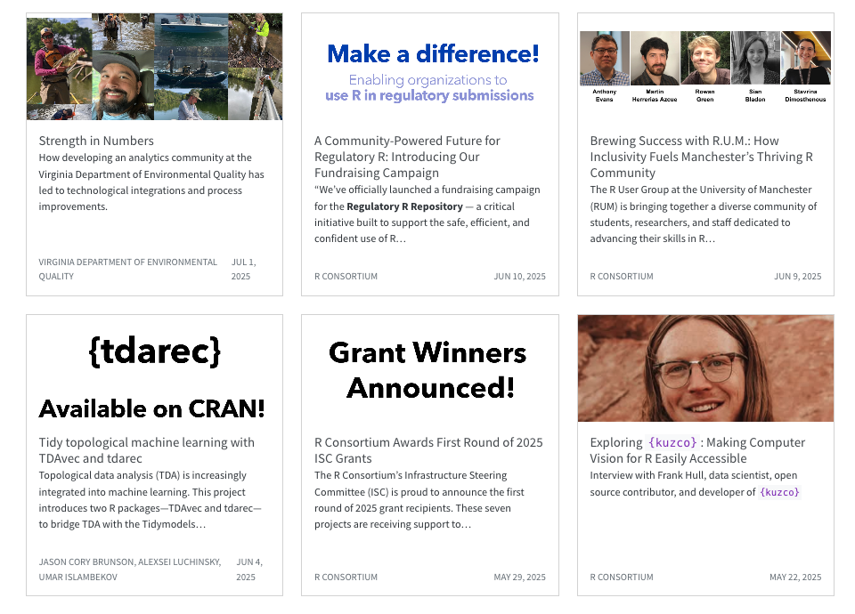
Why You Should Join the R Consortium
Collaborate with your peers across industry
Protect your investment in R
Provide leadership in the R Community
Support open source
Enhance the R ecosystem
Leverage the R Consortium platform

Slide 5
Agenda
Time | Speaker | Topic
09:30-09:45 | Mike K Smith (Pfizer) | Welcome
09:45-10:10 | Mike K Smith (Pfizer) | Introduction to Change Management
10:10-10:35 | Andy Nicholls (GSK) | From Training to Practice: A shift to Just in Time User Support
10:35-11:00 | Martin Brown (PPD) | Change management in a large CRO; investing for the future
11:00-11:30 | COFFEE
11:30-11:55 | Kieran Martin (Roche) | Getting Ready for submission with R
11:55-12:20 | Stuart Malcolm (Veramed) | Planning on R? Risks, Resources and Realism
12:20-12:45 | Yannick Vandendijck (J&J) | SAIL.R – Journey Towards R Software for Statisticians in Johnson & Johnson
12:45-13:45 | LUNCH

Slide 6
Agenda
Time | Speaker | Topic
12:45-13:45 | LUNCH
13:45-14:45 | Panel Discussion | Slido questions!
14:45-15:10 | Ruhul Amin (AZ) | R in Biometrics - AstraZeneca approach to enable R Shiny apps for Drug Project activities
15:10-15:35 | Sebastià Barceló (Cytel) | Navigating Change in a CRO – What I Wish I Knew 5 Years Ago About Transitioning to R
15:35-16:00 | Colin Gillespie (Jumping Rivers) | Can I trust this package?
16:00-16:15 | COFFEE
16:15 – 16:45 | Small group discussion | "Making Change Happen"
16:45-17:15 | Summary from discussions | Slido
17:15 – 17:30 | Closing remarks

Slide 7
Questions for small groups:
What next action can you take back to your org to help make another step forward towards using more open-source?
What is your “quick win” using open-source?
What question can you ask / what evidence could you provide to your organisation to help “unlock” acceptance of open-source?
How can you help build a community within your org to discuss this more? Who would you invite?

Slide 8
FAQ
Are you recording this?
Only audio and only to help us summarise after the event. No attributed quotes will be made. Please let us know if you are not happy to be recorded.
Will slides be made available?
Will collate slides from speakers at PSI AIMS subcommittee
Speakers, please share afterwards
Will you share a summary later?
Yes, we’ll write up a summary and post via PSI, R Consortium blog posts.
Will then publicise via LinkedIn.

Slide 9
Please share your thoughts…
LinkedIn
Mike K Smith - https://www.linkedin.com/in/mikeksmith/
Martin Brown - https://www.linkedin.com/in/martin-brown-68786b206/
Tom Ward - https://www.linkedin.com/in/tom-ward-02574020/
Bluesky / Mastodon / Linkedin:
#psichangemanagement

Slide 10
Slido – audience participation & questions
We’re using Slido to capture your questions and points for discussion.
Please post questions into slido during presentations, panel discussions, etc. and we’ll make sure they get addressed.
You can ask questions anonymously.
Go onto the slido page to upvote questions from others that you would like asked & answered.
We may hold questions for the panel discussion.

Slide 11
Slido – let’s practice!

Slide 12
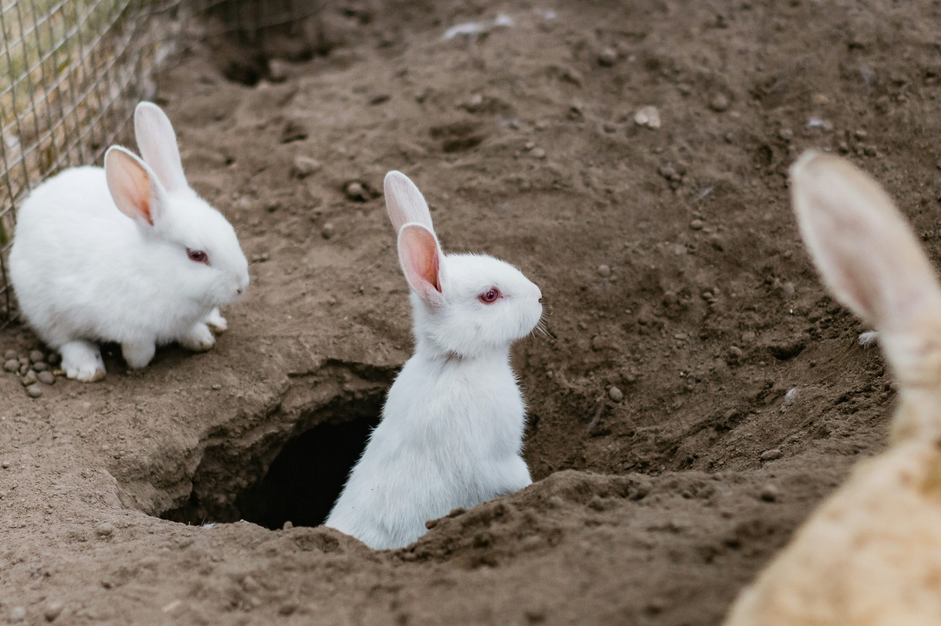
Let’s avoid those (technical) rabbit holes…
Our focus today is on people, processes and change management
Photo by Sincerely Media on Unsplash

Slide 13

Enough, Let’s Move On… (ELMO)
This Photo by Unknown Author is licensed under CC BY

Slide 14
Please do share your thoughts…

Slide 15

Change Management
Presented by Mike K Smith
(Pfizer R&D UK Ltd)
2025/07/03

Slide 16
Only 4 – 8 steps
The 4 (5?) P’s of change management
Purpose, Picture, Plan, Part to play
The 5 C’s of change management
Clarity, Communication, Collaboration, Culture, and Commitment
The 7 R’s of change management
Raised, Reason, Return, Risks, Resources, Responsibility, Relationship
The 8 steps of change management
Create a sense of urgency, Build a guiding coalition, Form a strategic vision, Enlist a volunteer army, Enable action by removing barriers, Generate short-term wins, Sustain acceleration, Institute change.
(pick a number and write a blog post about how there are <this> many steps in change management).

Slide 17
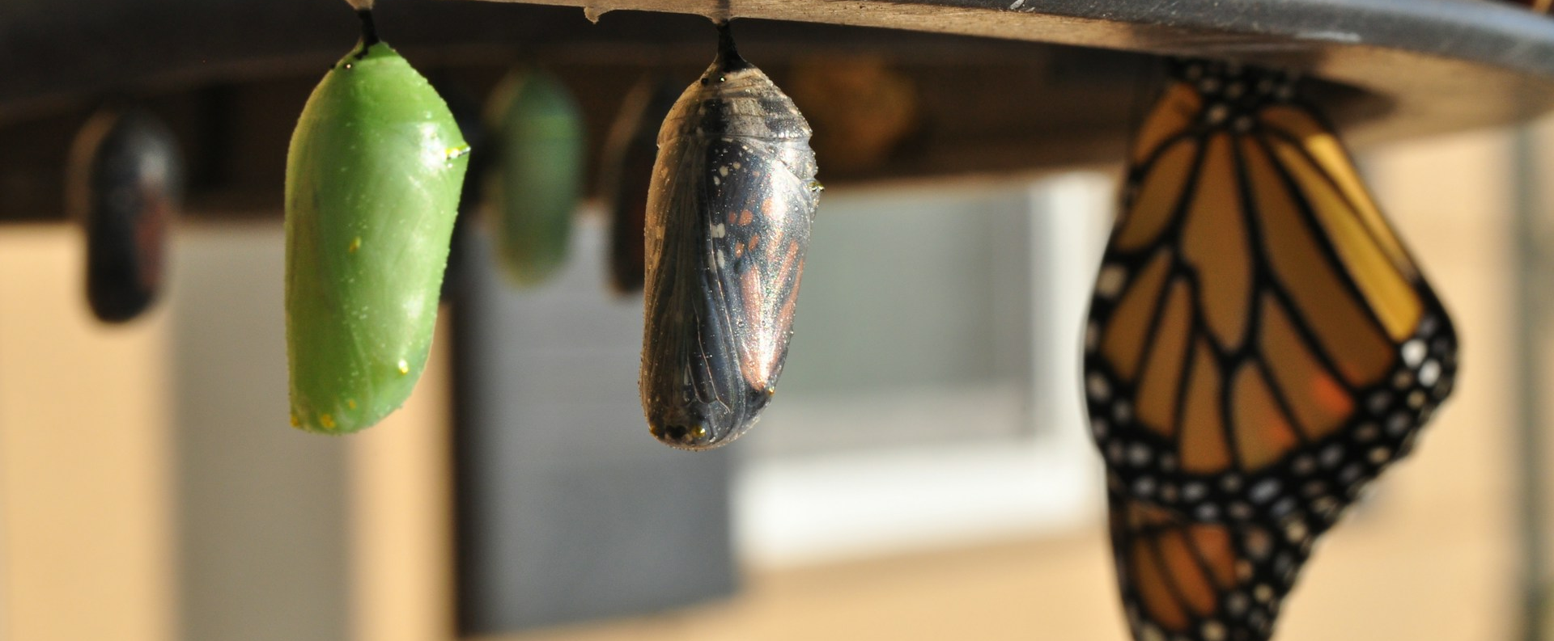
Transformational Change

Slide 18
Business readiness
Getting tools and infrastructure ready for new ways of working
The tech stuff
Easy to prove when something “works”, easy to articulate how far you’ve come and what is still needed before “release”.
GEEKS LOVE THIS BIT!

Slide 19
Business readiness
Getting tools and infrastructure ready for new ways of working
The tech stuff
Easy to prove when something “works”, easy to articulate how far you’ve come and what is still needed before “release”.
GEEKS LOVE THIS BIT!
Getting the business ready for the change to the new ways of working
The people and process stuff
This bit is hard work, takes a while, is hard to measure success or RoI.
Involves all levels of organisation – managers and individual contributors.
Often you’ll know only if you’ve done it BADLY.
FOCUS OF TODAY’S MEETING

Slide 20
Fear, Uncertainty, Doubt
Feelings about this transition may come out in “odd” ways:
“We’re not actually going to save that much money…”
“Now is not a good time…”
“Why change at all…?”
“What about this case / scenario…?”
“I have a bad feeling about this…”

Slide 21
Every single person is different
Here is dangerous, actually…
Don’t neglect these people
If you can “convert” these people,
they could be strong influencers. However, they could also take a
lot of time and energy to do so
Early adopters. Change agents. Golden retriever energy. It’s natural to gravitate towards
this group.
<Everyone else>: Meh
(Probably the majority)
Oh Lord, what NOW…?! Do I HAVE TO?
TBH this couldn’t come at a worse time…
YAHOO!
LET’S GO!!!!
TBH I’m already doing it.
Level of enthusiasm and engagement with change

Slide 22
In my experience…
From key stakeholders, SMEs:
A vision and a plan of how to get there.
From management:
A clearly communicated expectation. “We will, by <20yy>, …”

Slide 23
Every single person is different
Build relationships & trust Convince through PoCs Be responsive to feedback
Support and guide
Strong management direction: “We will, by <20yy>…” provides
clarity for this group
Empower & Encourage
Trailblazers - They will find “dead ends” and troubleshoot
<Everyone else>: Meh
Oh Lord, what NOW…?! Do I HAVE TO?
TBH this couldn’t come at a worse time…
YAHOO!
LET’S GO!!!!
TBH I’m already doing it.
Level of enthusiasm and engagement with change

Slide 24

In my experience…
Along the way
A quick proof of principle / concept – how do we show that this is even possible?
Find your “change agents” who can help listen for feedback, demonstrate and reassure those in doubt
Communicate, communicate, communicate - build materials, help docs, examples, vignettes, etc.
Build relationships & trust – reassure, show your working (communicate!)
Demonstrate – let people get hands-on early and provide constructive feedback.
Be ready to course-correct, adapt, feed back, revise

Slide 25

From proprietary to open-source
The culture shift.

Slide 26
From proprietary to open-source
The culture shift.
Foster a good working relationship with your IT group
Transactional with vendor
You pay for it, you get service, support, the whole package.
Open Source
Much more onus on individuals to deploy, maintain, develop and contribute.

Slide 27


From proprietary to open-source
The culture shift.
Process
Quality
Your SOPs and defined processes, work instructions may not explicitly refer to a specific software… but there may be a different approach when writing code / functions / applications using open source tools.

